Slide 1

Introduction to Database Systems
DBS211
Transactions

Slide 2
Week 8
Transactions
Lab 06 due Monday July 8th @ 11:59pm
Quiz 06 opens Wednesday July 3rd @ closes Friday July 5th at 11:59pm
Project 2 due August 9th @ 11:59pm

Slide 3
What is a Transaction?
A logical unit of work that must be entirely completed or entirely aborted. This ensures data integrity by ensuring all commands are successful or none of them execute
A group of commands that manipulates data stored in a database
Transactions are often broken into parts like
Like updating account info
Adjusting how many products are available after purchase
Concurrent transactions – when many transactions take place at once
Concurrency control – managing the execution of transactions

Slide 4
ACID
Atomicity: The entire of the operations that are included by the transaction performed successfully. Otherwise, all operations are canceled at the point of the failure and all the previous operations are rolled back
Consistency: This property ensures that all the data will be consistent after a transaction is completed according to the defined rules, constraints, cascades, and triggers
Isolation: All transactions are isolated from other transactions
Durable: The modification of the committed transactions persist in the database

Slide 5
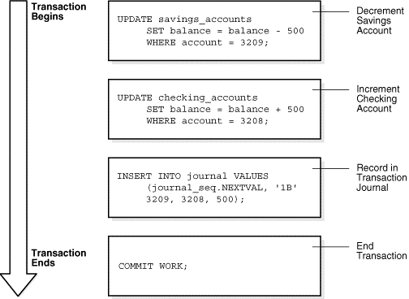
Example Transaction

Slide 6
Structure of a Transaction
A database transaction consists of 1 or more statements
Specifically, it consists of the following:
1 or more DML (Data Manipulation Language) statements, combined they constitute an atomic change to the database
1 DDL (Data Definition Language) statement
A transaction has a beginning and an end

Slide 7

Beginning of a Transaction
A transaction begins when the first executable SQL occurs
An executable SQL statement is one that generates a call to a database instance, including DML and DDL statements
Oracle assigns the transaction to an available undo data segment to cored the undo entries for the new transaction
A transaction ID is only allocated when an undo segment and transaction table slot are allocated in the first DML statement
Transaction ID: a unique ID of a transaction that represents the undo segment number, slot, and sequence number

Slide 8

End of a Transaction
A transaction can end under various circumstances
A transaction ends when any of the following occurs:
A user commits or rolls back a transaction without a SAVEPOINT clause.
Committing a transaction makes the changes permanent and visible to others.
Running a DDL command (CREATE, DROP, RENAME, ALTER) causes implicit commits before and after the command.
If DML statements are present, Oracle commits them before executing the DDL command.
Exiting Oracle Database utilities and tools normally causes an implicit commit.
Commit behaviour on user disconnection depends on the application and configuration.
Abnormal termination of a client process results in the transaction being implicitly rolled back using stored metadata.

Slide 9
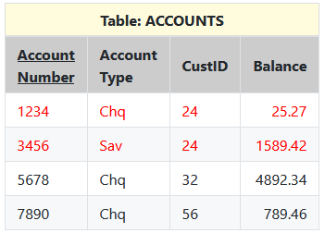
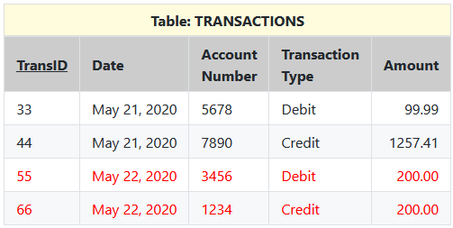
Real World Transaction Example
Credit (deposit) Debit (withdrawal)

Slide 10
Bank Transaction Process Example
Check if user has permission to withdraw money
SELECT accountno WHERE accountno = 3456 AND custID = &UsersCustomerID;
Check if there is enough money
SELECT accountno WHERE accountno = 3456 AND balance >= 200;
Create a record in the transaction table for the withdrawal
INSERT INTO transactions VALUES(55, sysdate, 3456, 'Debit', 200);
Update the accounts table record for the savings table to ensure the balance is correct
UPDATE accounts SET balance = balance - 200 WHERE accountNo = 3456;
Check if the user has permission to deposit money into the chequing account
SELECT accountno WHERE accountno = 1234 AND custID = &UsersCustomerID;
Create a record in the transaction table for the chequing deposit
INSERT INTO transactions VALUES(66, sysdate, 1234, 'Credit', 200);
Update the accounts table record for the chequing account to ensure balance is correct
UPDATE accounts SET balance = balance + 200 WHERE accountNo = 1234;
Send/display an confirmation code that the transaction was successful

Slide 11
Statement-Level Atomicity
SQL statements are atomic units of work: they either completely succeed or fail.
A successful statement differs from a committed transaction; it executes without error.
If an SQL statement fails, all its effects are rolled back (statement-level rollback).
Only the work of the unsuccessful statement is lost.
Previous work in the transaction remains unaffected.
The rollback nullifies the statement as if it never ran.
Side effects, like triggers, follow the atomic statement's success or failure.
Examples of errors causing rollback:
Inserting a duplicate primary key.
Deadlocks in single SQL statements.
Parsing errors (e.g., syntax errors) do not trigger rollbacks since they haven't run.

Slide 12
Basic Concepts of Transaction Control
COMMIT;
Ends any existing transaction in the session
SET TRANSACTION NAME ‘salary_update’;
Begins a transaction and names it ‘salary_update’
UPDATE employees SET salary = 80000 WHERE employeeid = 12345;
Updates the salary for employee 12345
SAVEPOINT after_emp_12345_salary_update;
Creates a save point named after_emp_12345_salary_update, enabling changes in this transaction to be rolled back to this point
UPDATE employees SET salary = 1200000 WHERE employeeid = 6789;
Updates the salary for employee 6789
SAVEPOINT after_emp_6789_salary_update;
Creates a save point named after_emp_6789_salary_update, enabling changes in this transaction to be rolled back to this point

Slide 13
Basic Concepts of Transaction Control
ROLLBACK TO SAVEPOINT after_emp_12345_salary_update;
Rolls back all changes in transaction ‘salary_update’, undoing the update to employeeid 12345’s salary change.
UPDATE employees SET salary 90000 WHERE employeeid = 12345;
Updates the salary for employeeid 12345 to 90000
ROLLBACK;
This rollback all changes, ending the transaction
SET TRANSACTION NAME ‘salary_update_attempt_2’;
Begins a new transaction in the session and names it salary_update_attempt_2
UPDATE employees SET salary 100000 WHERE employeeid = 12345;
Updates the salary for employeeid 12345 to 1000000
UPDATE employees SET salary 90000 WHERE employeeid = 6789;
This statement updates the salary for employeeid 6789 to 90000
COMMIT;
This statement commits all changes made in salary_update_attempt_2’, ending the transaction.

Slide 14
Savepoints
Definition: User-declared intermediate markers within a transaction.
Function: Internally resolved to an SCN.
Purpose: Divide long transactions into smaller parts.
Error Handling: Allows rolling back to a specific point without resubmitting every statement.
Rollback Details:
Only statements after the savepoint are rolled back.
The specified savepoint is preserved; subsequent savepoints are lost.
Releases locks acquired after the savepoint; retains locks from before.
Continuity: Transaction remains active and can be continued after rollback to a savepoint.

Slide 15
Commits
Definition: Ends the current transaction and makes all changes permanent.
Actions on Commit:
Generates an SCN for the commit.
Records the transaction's SCN in the undo tablespace.
Log writer (LGWR) writes remaining redo log entries and the transaction SCN to the online redo log.
Releases locks on rows and tables, allowing waiting users to proceed.
Deletes savepoints and performs commit cleanout.
Removes lock-related transaction info from modified blocks in SGA if no other session is modifying them.
Marks the transaction complete.
Post-Commit:
Users can view changes immediately.
Commit is typically a fast operation, regardless of transaction size.
LGWR's physical disk I/O is the lengthiest part, but it is minimized by background writing.
Commit Behaviour:
Default: LGWR writes redo synchronously, making transactions wait for the redo to be on disk.
Optional: Redo can be written asynchronously to reduce commit latency.

Slide 16
Rollback
Definition: Undoes changes made by SQL statements in an uncommitted transaction.
Post-Rollback:
Effects of the transaction are removed.
Rollback Actions:
Undoes all changes using undo segments.
Transaction table entry points to undo data, which is read and reversed.
Inserted rows are deleted.
Updated rows are reversed.
Deleted rows are reinserted.
Releases all data locks held by the transaction.
Erases all savepoints.
Ends the transaction.
Duration: Depends on the amount of data modified.

Slide 17

Summary
What are Transactions
ACID
Structure of a Transaction
Beginning of a Transaction
End of a Transaction
Some examples
Statement-Level Atomicity
Transaction Control
Basic Concepts of Transaction Control
Savepoints
Commits
Rollbacks

Slide 18
Week 8
Transactions
Lab 06 due Monday July 8th @ 11:59pm
Quiz 06 opens Wednesday July 3rd @ closes Friday July 5th at 11:59pm
Project 2 due August 9th @ 11:59pm

